Slide 1
Fundamental Issues in Software Design

Slide 2
Software Design
  General definition of design
    “… the process of applying various techniques and principles for the purpose of defining a device, a process, or a system in sufficient detail to permit its physical realization.”
  Goal:
    To produce a model or representation depending on the SRS document, that will later be built
  Engineering or Art?

Slide 3
Software Design
Design activities having two important parts
  High-level design
    Outcome is program structure or software architecture
  Detailed design
    The data structure and the algorithms of different modules are designed
  Question
  How to distinguish a good design from a bad design?

Slide 4
Software Design
  Good design is not accomplished by chance
“The beginning of wisdom for a computer programmer is to recognize the difference between getting a program to work, and getting it right.” [Jackson]
  Fundamental concepts provide the framework for “getting it right”

Slide 5
Design Fundamentals
  Abstraction
  Refinement
  Modularity
  Software Architecture
  Control Hierarchy
  Data Structure
  Software Procedure
  Information Hiding

Slide 6
Design Fundamentals
  Abstraction
    Levels of detail/language used to describe a problem
…notion of “abstraction” permits one to concentrate on a problem at some level of generalization without regard to irrelevant low level details; use of abstraction also permits one to work with concepts and terms that are familiar in the problem environment… [Wasserman]
    Types of abstractions
      Procedural abstraction
      Data abstraction

Slide 7
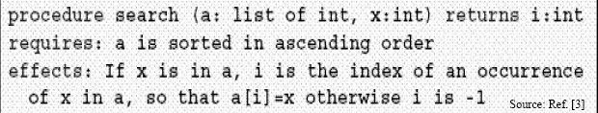
Procedural Abstraction
A procedure maps from input to output parameters, may modify its parameters, may have side effects, may return a result
Procedural abstraction describes what a procedure does, ignore how to does it.
  Different implementations of the abstraction can differ over details; one implementation can substitute others

Slide 8
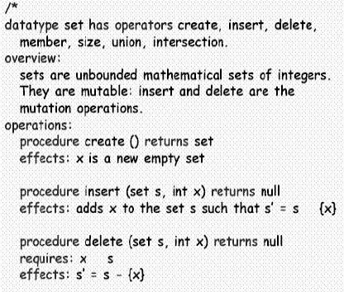
Data abstraction
Defining data abstractions:
  Name the data type
  List the operations
  Give a procedural
  abstraction for each
  abstraction

Slide 9
Design Fundamentals (cont.)
  Refinement
    Top-down strategy
In each step, one or several instructions of the given program are decomposed into more detailed instructions. This successive decomposition or refinement of specification terminates when all instructions are expressed in terms of any underlying computer or programming language. [Wirth]
  Modularity
    Divide software into separate components that are integrated to solve problem requirements

Slide 10
Design Fundamentals (cont.)
  Software Architecture
    The hierarchical structure of procedural components & the structure of data
    Transition between analysis and design
  Control Hierarchy/Program Structure
    Organization of modules that implies a hierarchy of control
    Metrics - depth, width, fan-out, fan-in
    Visibility & connectivity

Slide 11
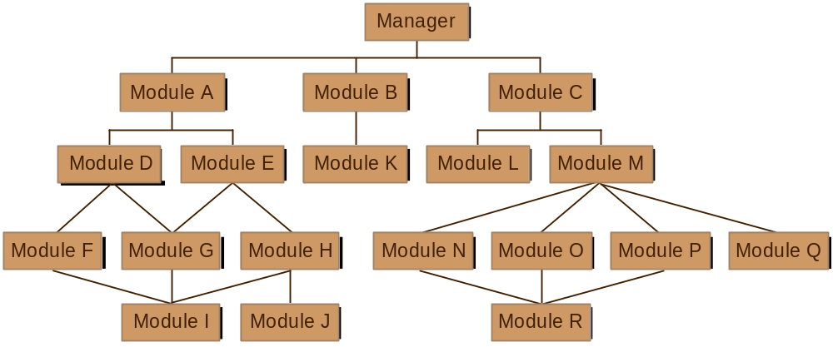
Control Hierarchy

Slide 12
Design Fundamentals cont..
  Data Structure
    Logical representation of the relationship among individual data elements
    Scalar, sequential vector, array, linked list, hierarchical data structure
  Software Procedure
    Processing details of each module
    Precise specification includes sequence of events, decision points, repetitive operations, data organization

Slide 13
Design Fundamentals cont..
  Information Hiding
    Modules should be “characterized by design decisions that each hides from all others”
    Modules are designed so that information within a module is inaccessible to other modules with no need for the information
    Defines and enforces access constraints

Slide 14
Good Software Design
Can vary depending on the application for which it is being designed
Characteristics
  Correctness : should correctly implement all the functionalities of the system
  Understandability: should be easily understandable
  Efficiency
  Maintainability: easily adaptable to change

Slide 15
Understandability features
Should use consistent and meaningful names for various design concepts
Design should be modular, that is it should use a cleanly decomposed set of modules
Should neatly arrange the modules in a hierarchy e.g. tree-like diagram

Slide 16
Modularity
Take the advantage of divide and conquer principle
Problem is decomposed into modules, and make as much as possible functionally independent to each other
Reduces complexity of design solution

Slide 17
Functionally independence
Performs a single task or function
Advantages:
  Error Isolation: Reduce error propagation
  Scope for reuse: reuse possible due to less dependency
  Understandability:
    Complexity is reduced and can be understood in isolation

Slide 18
Clean decomposition
Modules should be less independent of each other satisfying the property like high cohesion and low coupling
M1
M1
M2
M3
M4
M2
M3
M4
M5
M5
Modular design
Poor design

Slide 19
Cohesion
Represents how tightly bound the internal elements of the module are to one another
Tries to capture the intra-module characteristics
Gives the designer an idea about whether the different elements of a module belong together in the same module
High cohesion of a module is desired

Slide 20
Cohesion contd..
Different classes of cohesion exist
Coincidental
Logical
Temporal
Procedural
Communicational
Sequential
Functional
Low
High
Coincidental : performs a set of tasks which are relate to each other very loosely
Logical : If all elements of the module perform similar operations
Temporal :
    Elements are related with time and executed together.
    Modules that perform activities like “initialization”, “clean up” and ”termination” are usually temporally bound.

Slide 21
Cohesion contd..
Procedural : if the set of elements are all part of a procedure to carry out some steps to achieve an objective
Communicational: elements that are related by a reference to the same input/output data
Sequential : if the elements of a module form the parts of a sequence, where the output from one element of the sequence is input to the next
Functional : if the different elements of the module cooperate to achieve a single function

Slide 22
Coupling
All the modules in a system can not be independent of each other
The more connection between the modules more connected they are
The fewer and simpler the connections – easier to understand and modifiable
Coupling determines the strength of interconnections between modules or the measure of interdependence among modules
Low coupling is desired within the modules

Slide 23
Coupling
Degree of coupling between two modules depends on their interface complexity
  Interface complexity is determined by the number of types of parameters that are interchanged during invocation of function
Interface Type of Type of
Complexity Connection Communication
Low Simple To module Data
Obvious by name
High Complicated To internal Control or
obscure elements Hybrid

Slide 24
Coupling contd..
Types of couplings
  Data coupling: communicate using elementary data
  Stamp coupling: communicate using composite data
  Control coupling: data from one module used to direct the order of instruction execution in another
  Common coupling: share same global data item
  Content coupling: if their code is shared e.g. a branch from one module into another
Data
Stamp
Control
Common
Content
Low
High

Slide 25
Neat Arrangement
0
1
2
Represents the control hierarchy
Characterized by the following:
    Layered solution
      Modules are arranged in layers
      Superordinate/subordinate modules
      Visibility : if a module A directly/indirectly calls another module B then module B is visible to module A
    Control abstraction
      Should invoke the functions of the modules in the layer immediate below to it
    Depth and width
      Provide an indication of the number of levels of control and overall span of control respectively
    Fan-out
      Measures the number of modules directly controlled by a given module
    Fan-in
      Number of modules directly invoking a given module.
      High fan-in represents code-reuse and is encouraged
M1
M2
M3
M4
M5

Slide 26
Software Design Approach
Two design approach
  Function-oriented
    System can be viewed as something that performs some operations
    Starting with a high level function, each function is successively redefined into more detailed function
    System state is centralized and shared among different functions
  Object-oriented
    System is viewed as a collection of objects
    The system state is decentralized among objects and each object manages its own state information.
    Objects have their own internal data which define their state

